Slide 1


TEAM NAME: DIVINE
UNITED AIRLINES
HACKATHON
SUBMITTED BY:
AVINANDAN PATEL MAYANK RAJ

Slide 2
TABLE OF CONTENTS
EXECUTIVE SUMMARY
INSIGHTS
ANALYSIS
RECOMMENDATIONS
MODELLING
CONCLUSIONS

Slide 3
EXECUTIVE SUMMARY
United Airlines is focused on optimizing Average Handle Time (AHT) and Average Speed to Answer (AST) to improve operational efficiency and customer satisfaction. High AHT leads to longer calls and increased costs, while high AST causes customer frustration and call abandonment. Through analysis of call data, agent performance, customer sentiment, and transcripts, we identified key factors driving long AHT and AST, including agent behavior, complex call types, negative sentiment, and inefficiencies in the IVR system.
Key findings revealed that complex issues and escalations contribute heavily to long AHT, while sentiment impacts call durations significantly. Inefficient IVR processes also unnecessarily escalate simple issues to human agents, worsening AHT and AST. To address these issues, we recommend targeted improvements such as enhanced agent training, optimizing the IVR system to handle complex queries, and implementing real-time monitoring of sentiment and call types. These strategies will streamline operations, reduce call durations, improve response times, and enhance customer satisfaction, helping United Airlines maintain a competitive edge.

Slide 4

INSIGHTS

Slide 5



INSIGHTS
182/ 383
EFFICIENT AGENTS
The agent whose AHT< 11.63mins, that is the mean handling time.
8532/ 66653
ELITE CUSTOMERS
The customer who are loyal with the company having elite score > 3.
Company can give the reward of loyalty without compromising the resources and the quality of service, by allocating the efficient agents to the elite or loyal customers.

Slide 6
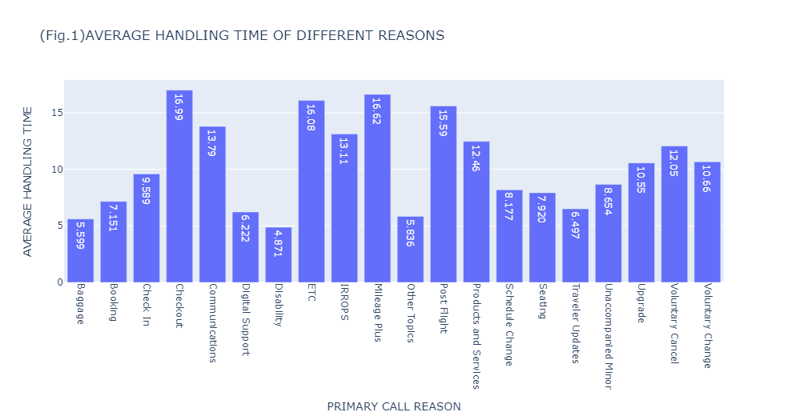
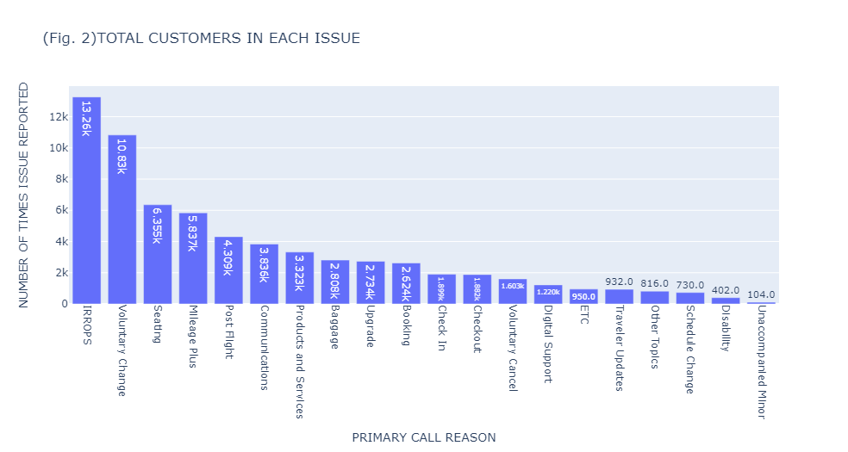
CALL-REASON INSIGHTS
(Average Handling Time)
IRROPS and Voluntary Change are the two major issues reported by the customers while Disability and Unaccompanied Minor being the minor (Fig. 2 ).
(Fig. 1) depicts Check out, Mileage Plus and ETC being such issues with maximum handling time. So, we need to optimize by enhancing the agents training.
So from (Fig. 1) and (Fig. 2) average handle time for Check out is maximum but, the number reported issues compared to the handle time does not shows the same trend.

Slide 7
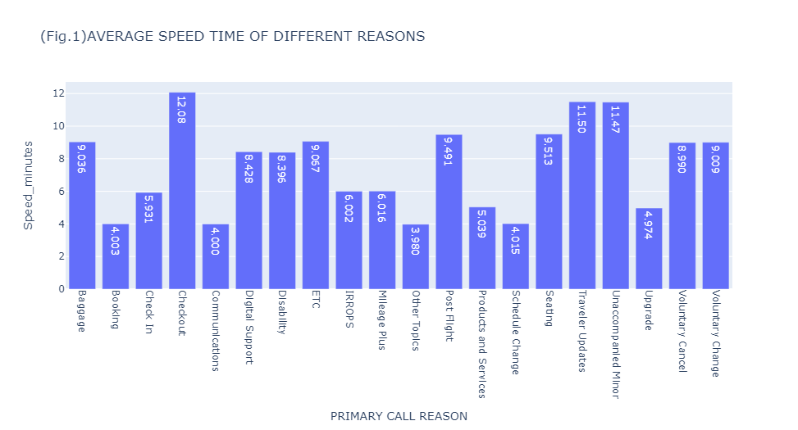
CALL-REASON INSIGHTS
(Average Speed Time)
IRROPS and Voluntary Change are the two major issues reported by the customers while Disability and Unaccompanied Minor being the minimum (Fig. 2 ).
(Fig. 1) depicts Check out, Unaccompanied Minor and Travel Updates being such issues with maximum speed time. So, we need to optimize by enhancing the IVR, AI or through messages and notifications or WhatsApp's chatbots.
So from (Fig. 1) and (Fig. 2) average speed time for Check out is maximum but, the number of reported issues compared to the speed time does not shows the same trend.
(Fig. 1) and (Fig. 2) depicts average speed time for Unaccompanied Minor is the second maximum but, the number of reported issues shows opposite trend as it’s least frequent reason. Hence, we can solve this problem with IVR leading to optimized AST.

Slide 8
ANALYSIS

Slide 9
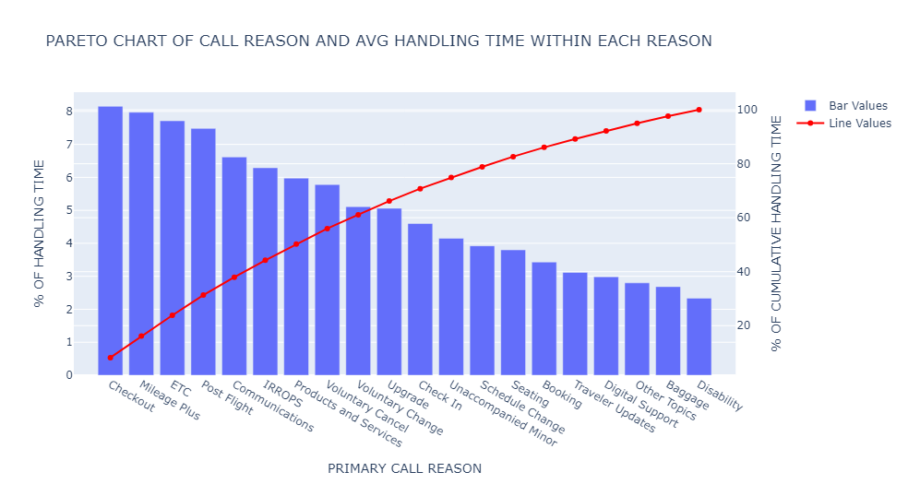
CALL-REASON ANALYSIS
(Average Handling Time)
To understand the major contributors in high Average Handling Time (AHT) we use ABC Analysis based on Pareto Chart.
After Applying ABC Analysis we divide the reasons into classes i.e., A, B & C. Where Class A reasons consist of almost 70% of AHT, Class B reasons contain 20% and Class C reasons contain 10%.
Class A Reasons
Checkout, Mileage Plus, ETC, Post Flight, Communications, IRROPS, Products and Services, Voluntary Cancel, Voluntary Change,
Upgrade, Check In
Class B Reasons
Unaccompanied Minor, Schedule Change, Seating, Booking,
Traveler Updates
Class C Reasons
Digital Support, Baggage, Disability, Other Topics

Slide 10
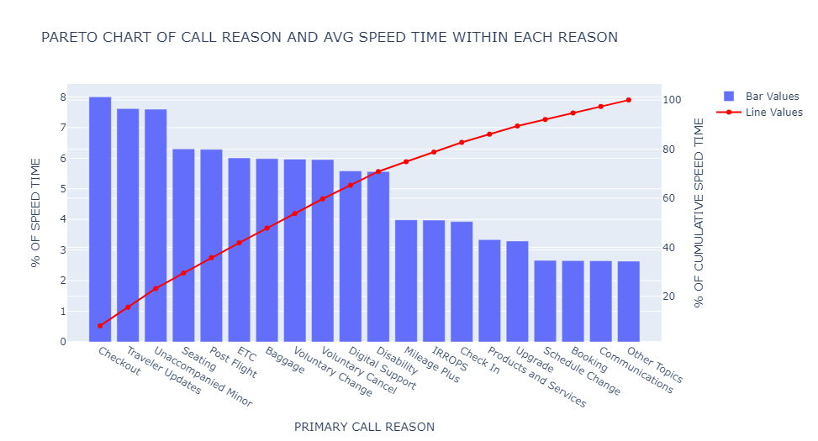
CALL-REASON ANALYSIS
(Average Speed Time)
Again, to understand the major contributors in high Average Speed Time (AST) we use ABC Analysis based on Pareto Chart.
After Applying ABC Analysis we divide the reasons into classes i.e., A, B & C. Where Class A reasons consist of almost 70% of AST, Class B reasons contain 20% and Class C reasons contain 10%.
Class A Reasons
Checkout, Travel Updates, Unaccompanied Minor, Seating, Post Flight, ETC, Baggage, Voluntary Change, Digital Support and Disability
Class B Reasons
Mileage Plus, IRROPS, Check In, Product Services and Upgrades
Class C Reasons
Schedule Change, Booking, Communication and Other Topics

Slide 11
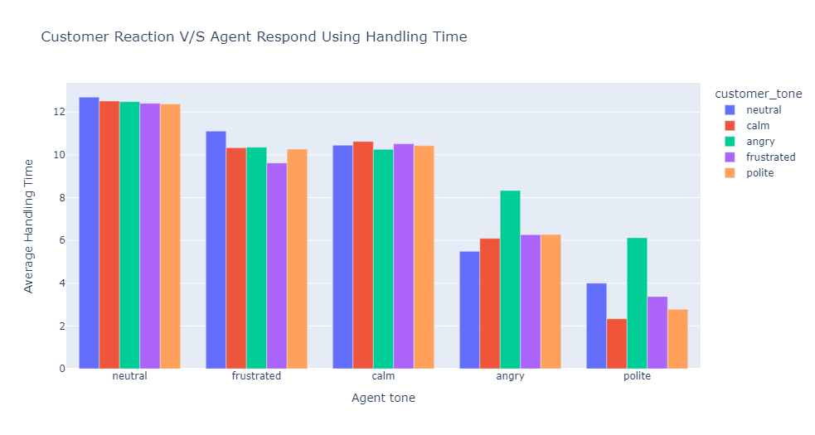

SENTIMENT ANALYSIS (Average Handling Time)
From the data we can infer that the agent’s tone derives the handling time of the respective customer’s tone.
In graph, it’s clearly depicted that neutral, frustrated and calm tone of the agent leads to higher handling time that is 12.5 mins, 10.33 mins and 10.45 mins respectively.
Polite tone shown by the agent lead to lesser handling time. As in this behavior, the handling time is minimum that is 3.7 mins.

Slide 12
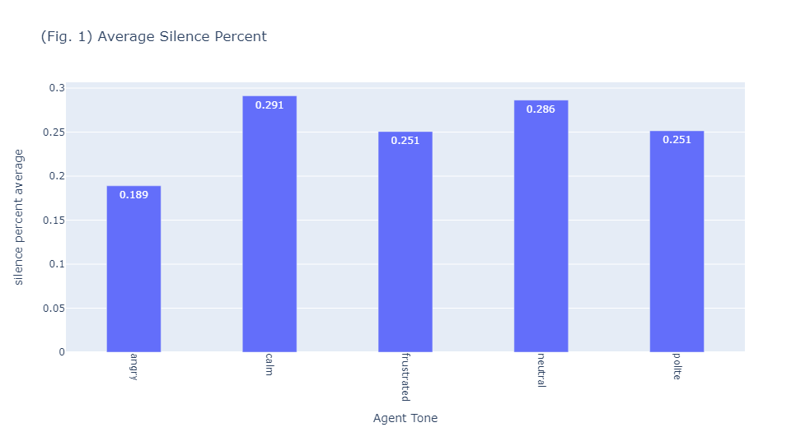
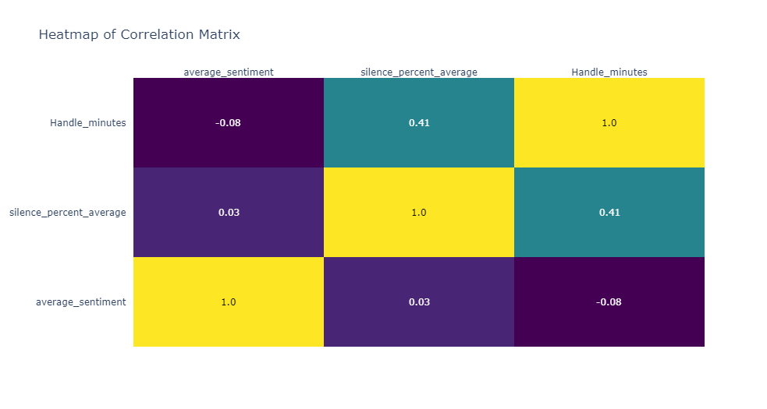
SILENCE-SENTIMENT ANALYSIS
(Average Handling Time)
From the Correlation ‘Heatmap’, we infer that average silence percentage is moderately correlated with ‘Handle Time’. Correlation of these two variables is 0.41.
Fig. 1 , depict that Average silent percentage is higher for calm, neutral tone of agent.
There is no relation found between ‘Handling Time’ and ‘Average Sentiment Score’.

Slide 13
RECOMMENDATIONS

Slide 14
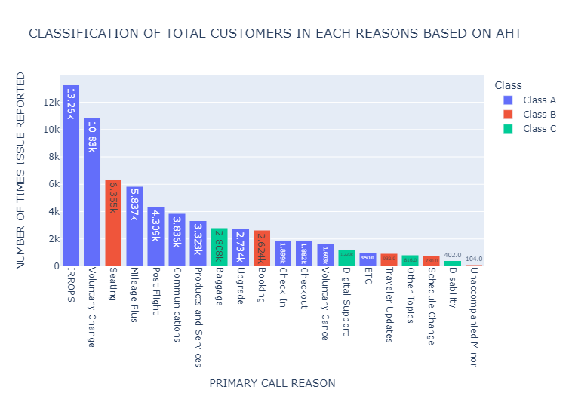
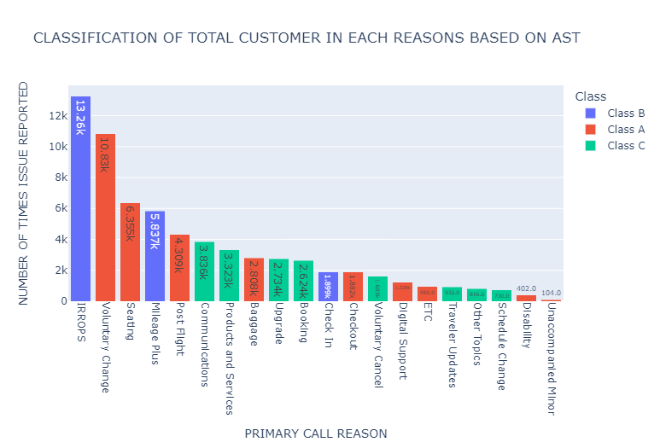
RECOMMENDATIONS FOR CALL-REASON
Under Class A, IRROPS, Voluntary Change and Mileage Plus, Post Flight comprise of almost 55% of calls made by the customers. So Company should prioritize such reasons.
Seating & Booking come under Class B but In terms of Issues reported by total number of customers it cover substantial amount of 13%. So If Company can tackle these issues in IVR we can reduce our AHT.
For Class C reasons, Company may build pre-defined FAQ or Guidelines through websites or solve in IVR.
Although Unaccompanied Minor and Disability are on Class A but the call reported is less than 1 %, while IRROPS and Mileage Plus are in Class B but it comprises of almost 30% of calls made by the customers. So, company need to use IVR for Class A and prioritize Class B.
AI and Chatbots could be used initially to reduce the speed time to minimize lesser important class of reasons.

Slide 15
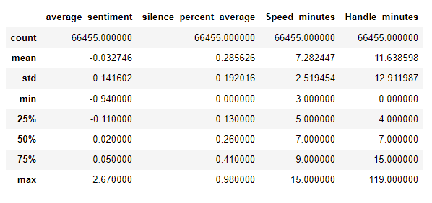
RECOMMENDATIONS FOR SENTIMENT
Sentiments are correlated to the AHT and found no correlation with AST.
Agents need to be trained to recognize and manage customer emotions more effectively. Providing agents with this kind of training will help them deal tense situations, keeping calls shorter and more focused on resolving the issue rather than emotional escalation. For ex: in neutral, calm and frustrating case the AHT is greater than 10 mins which is more than normal time.
Active Listening, Tone Modulation and proactive questioning helps the agents ask direct, solution-oriented questions early, toward resolution. Hence, reducing the AHT which often gets extended.
Sentiment-Based Call Routing: Use sentiment analysis from previous calls or historical data to route calls based on agent performance. For instance, highly skilled agents who AHT < 11.63 mins(mean Handling Time) with a track record of handling frustrated customers efficiently with greater AHT than the mean handling time, can be assigned to calls for customer with negative sentiment. Hence, optimizing the AHT.
Also to minimize the sentiment of the premium customers and maintain their loyalty by allocating the efficient agents to them.

Slide 16
MODELLING

Slide 17
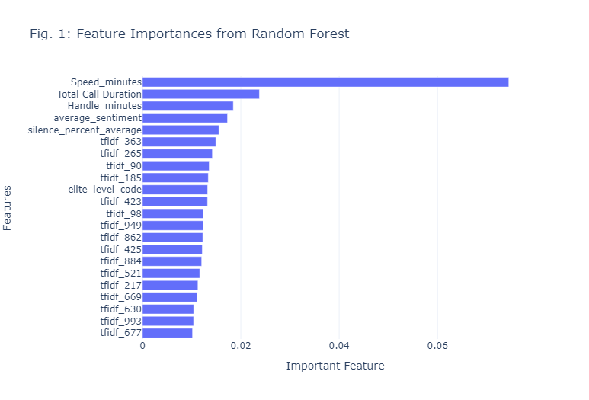
MODELLING
Using TFIDF (Term Frequency-Inverse Document Frequency), the given transcript was converted to numerical data based on its frequency and made it as features to predict Call-reasons.
Features other than call-transcript are: AHT,AST, Call Duration (AHT+AST), Average Sentiment and Silent percentage average
For modelling, Logistic regression and Random Forest were applied. To decide the important feature we chose Random Forest, and threshold of 1%. As a result, 21 important features were found important as shown in Fig. 1 .
These 21 features were again applied in the modelling. It was found that there is an increase in our accuracy by 3% that is in random forest from 37% to 40%
IMPORTANT INSIGHT: Out of 21 features, the average speed time (AST) is the most important feature to predict reason of the call.

Slide 18
CONCLUSION

Slide 19
CONCLUSION
The Data Analysis and Modelling based on the real-time data of United Airlines' call handling performance shows some crucial areas for improvement. Hence, there is a need to enhance both operational efficiency and customer experience. The following insights and recommendations will be useful:
Average Handle Time (AHT): IRROPS and Voluntary Changes are the leading contributors to escalated AHT, i.e. 55% of total calls and consistently exceeding the mean handle time of 11.63 minutes. Mileage Plus and ETC queries have some of the highest AHT, despite fewer reported cases, indicating inefficiencies in addressing these issues. Percentage difference between the most frequent and less frequent call reasons of AHT is 51.5% which can be optimized.
Sentiment Impact calls where customers shows negative sentiments (e.g., frustration) result in an AHT exceeding 10 minutes on average, compared to 3.7 minutes for calls handled with a polite agent tone. Sentiment based call routing for agents who excel at handling frustrated customers, optimizing both response time and satisfaction. This could lead to an estimated 20% reduction in AHT.
Silence in Calls: Average silence percentage is moderately correlated with longer AHT (correlation coefficient of 0.41), indicating that increased silent periods.
Average Speed to Answer (AST): Unaccompanied Minor and Travel Updates calls have high AST, despite having low-frequency. Hence, there is scope of improvement in automated handling. Prioritize top call types which accounts for the bulk of calls and cause the highest AHT.
Optimize the IVR System: AST can be reduced by 15% by automating handling of low-frequency, high-AST issues like Unaccompanied Minor and Travel Updates through AI driven approach.
Out of 21 features obtained by testing, the average speed time (AST) is the most important feature to predict reason of the call.
After model implementation on test data, an increase in our accuracy by 3% that is in random forest from 37% to 40% was found.
This enriched conclusion combines actionable insights derived from the data with measurable improvements, offering a clear path to optimizing United Airlines' call center operations.

Slide 20

Thank You

